Slide 1
Image Manipulation
Scott Stoudt

Slide 2
Project Goal
Create a simple interactive program that allows the user to manipulate and change an image in different ways
Color
Orientation
Image Quality
Create and integrate functions for each image modification
Use and modify the imageGetPixel() and imageSetPixel() functions from ppm.h/c files to create the desired effects

Slide 3
What’s Changed?
Implemented
Excluded
Greyscale (Black & White)
Red/Green/Blue Only
Negative
Sepia
Vertical/Horizontal Flips
Pixelate
Tint/Shading
Color Reduction
Blurry Effect
Replaced with pixelate
Resizing
Specific Color Shifts

Slide 4
The Programming
Functions prompted by user input
Certain modifications require user specified instructions
Same basic concept for each modification
Triple For-loop (row, col, chan)
imageGetPixel() on original image
Modification of pixel or individual color occurs
imageSetPixel() places modified pixel/color in a blank image “new____.ppm”

Slide 5
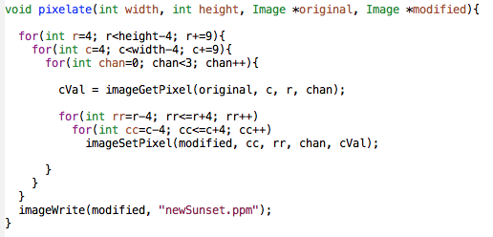
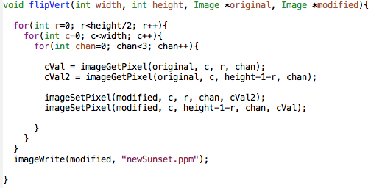

Slide 6
Putting It All Together
Next…Interactive Demo

